Slide 1
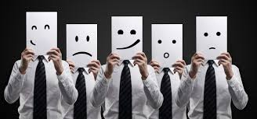
Customer with many faces: dealing with them all
Alina Marusyk,
October 2014

Slide 2
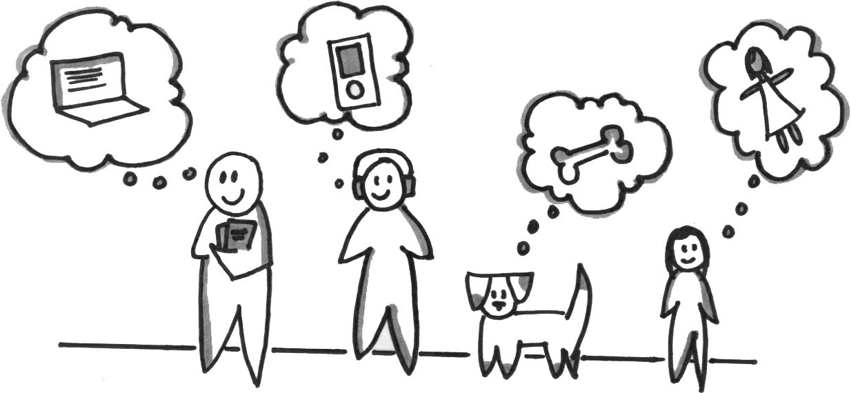
Customers - who they are?
A person (or group of people) who has a need and want to satisfy this need

Slide 3

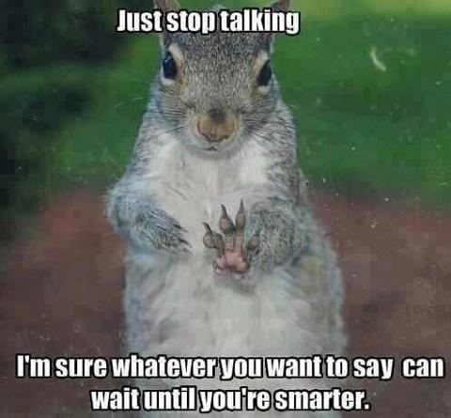
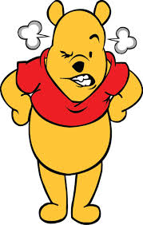
What is driving us crazy
Unclear requirements
Changing mind
Forgetting deals
“Stone wall” – no response
Doesn’t matter what your name is…
Saying how to do instead of what
“Why don’t you do that during weekend”
“Calling names”
“Yes man”
Brilliant ideas at the middle of the sprint
Forwarding your e-mail to your manager
……….

Slide 4

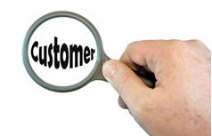
Why I decided to create these slides?
Everyone of us has customers
Customers are also people. People aren’t difficult, they’re just different
Share my experience and knowledge in dealing with various types of clients
Understanding customers better can save time, nerves and energy; help increase customer satisfaction
Try to walk in their shoes

Slide 5
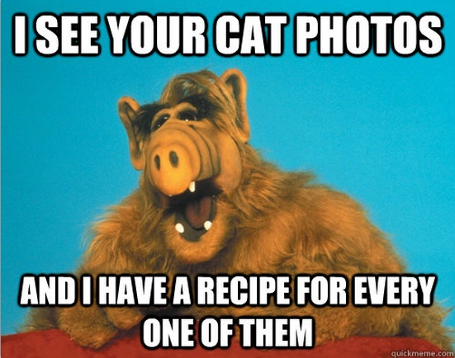
How to deal with your customers?

Slide 6

Steamrollers
Personality:
Hostile and pushy
Impatient
Controlling (micromanagement)
Superior
Your goal: command respect
Your behavior:
Listen carefully, let him/her talk first
Be extremely patient
Express your points clearly, providing argumentation
Don’t give hollow promises
Use accurate quantified data to back-up your response

Slide 7

Snipers
Personality:
Secret attacks and hidden back-stabbing
Negative undertone and superior attitude
Not sticking to commitments
Your goal: bring the sniper out of hiding
Your behavior:
Be aware of what is happening
Surface the attacks with questions
Point out facts and consequences
Try to provide peaceful alternative
Seek group confirmation (snipers hate be exposed to others)

Slide 8
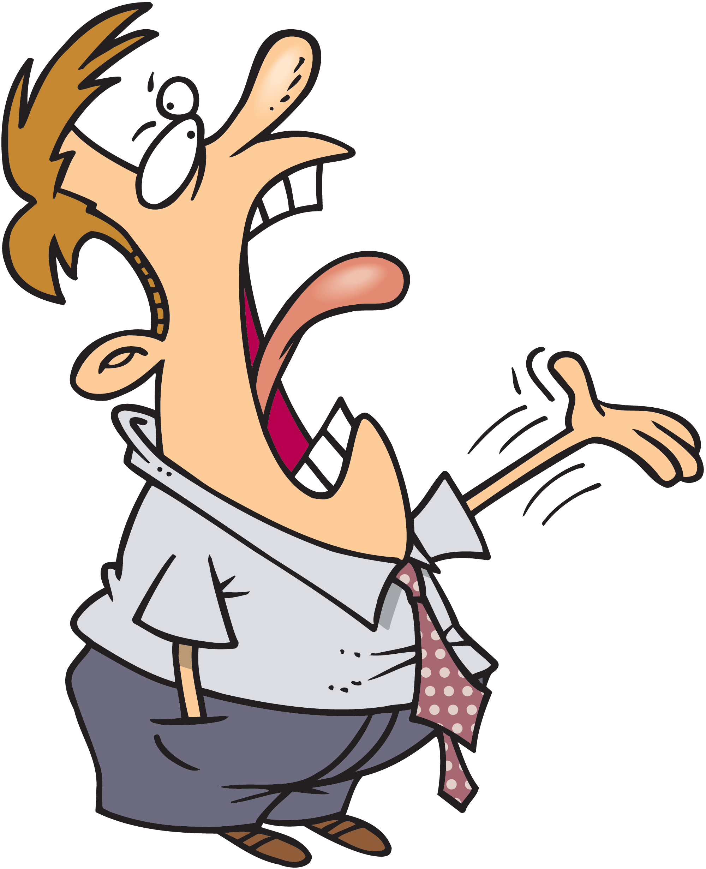
Chronic Complainers
Personality:
Points out problems, never offers solutions
Feels powerless
Strong sense of “what should be happening”
“Judgmental”
Your goal: form a problem-solving environment
Your behavior:
Listen and acknowledge , but don’t agree with everything
Ask questions to make them think
Focus on problem-solving. Ask them to state expected result clearly
State facts – avoid arguments

Slide 9
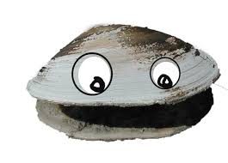
Clam
Personality:
Silent
Unresponsive
Your goal: persuade them to talk
Your behavior:
Ask open questions
Provide enough time for response, but set time limits
Write follow-ups
Present two options and ask them to choose

Slide 10
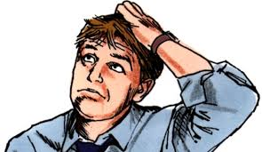
Uncertain
Personality:
Postpones decisions until it’s too late
Non demanding
Seeks assurance
Always in state “I don’t know/gathering information”
Your goal: help uncertain make decisions
Your behavior:
Give scenarios – either this or that will happen. Whish is best. Clarify options
Establish trusting relations
Make it easy for them to be direct by being pleasant

Slide 11


Know-It-All
Personality:
Demanding
Technically sound
Good knowledge about the product
Sometimes think your solutions are immature
Your goal: open his mind to new ideas
Your behavior:
Turn them into a mentor
Ask for their opinion
Listen carefully
Present your views as alternatives
Be prepared and know your staff

Slide 12
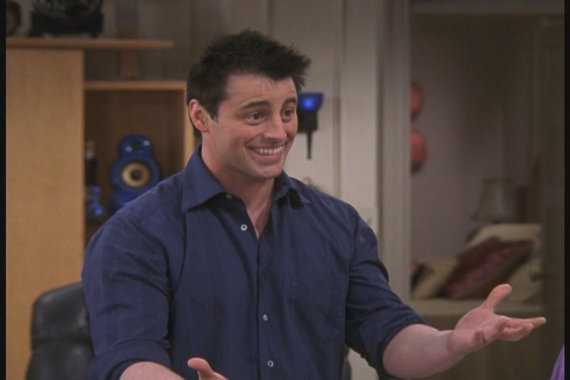
Buddy
Personality:
Talkative
Discusses a lot
Warm and good-natured
Quick to agree, slow to deliver
Your goal: get a commitment you can count on
Your behavior:
Take personal interest in them
Focus on realistic commitments
Stick to the topic

Slide 13
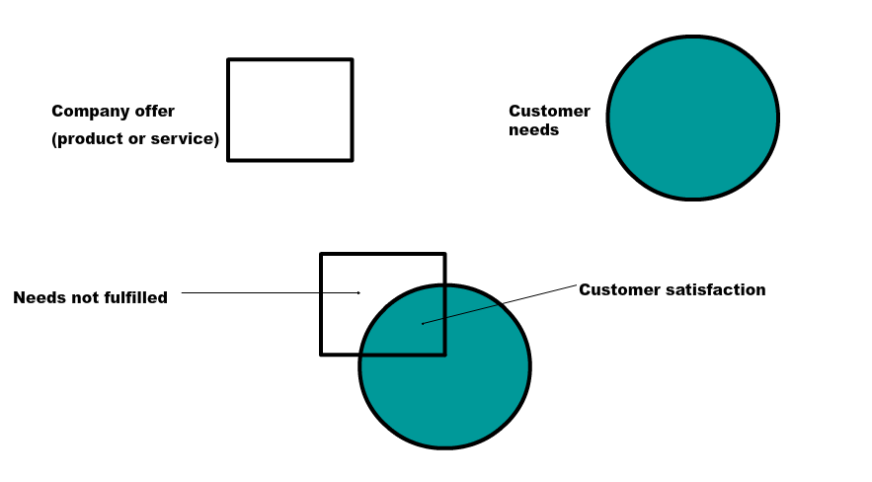
Customer satisfaction model (Teboul)
Total satisfaction is achieved when offer matches the need

Slide 14
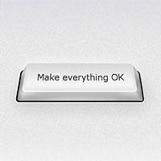
What customers really want
Solutions for his/her problems
Service
Security and guarantees
Stable performance
Being into the loop
Good price

Slide 15
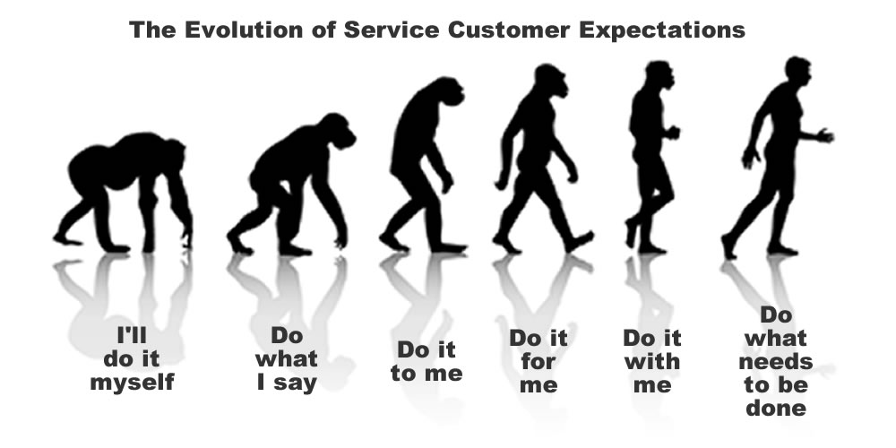

Slide 16
Why customers leave

Slide 17



Difference between…..
Good service
Bad service
Excellent service

Slide 18
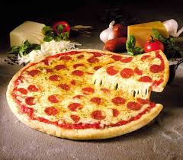
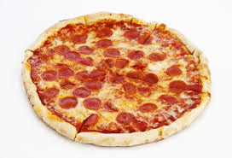
Good customer service
When customer gets what meets his/her expectations

Slide 19
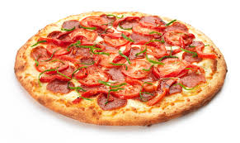
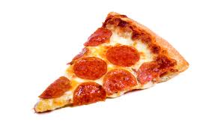
Bad customer service
When customer gets much less then expected

Slide 20

Excellent customer service
When customer get a little more than expected, Good service becomes Excellent
+

Slide 21

Customer satisfaction is like an election held every day, and the people vote with their feet.
If dissatisfied, they walk to your competitor.
Notes:
To view this presentation, first, turn up your volume and second, launch the self-running slide show.

Slide 22
Statistics
86% of customers expect better services than they had 5 years ago
97% switch loyalty because of bad customer service
35% say that a mere “Sorry” could have stopped them from moving off
The cost of acquiring new customers are 5 times the cost of keeping old ones happy

Slide 23








5 ways to
build trust
5
Notes:
Along the way we’ve discovered…

Slide 24

VALUE
THE
RELATIONSHIP
Notes:
The first rule is: Treat your audience as king.

Slide 25












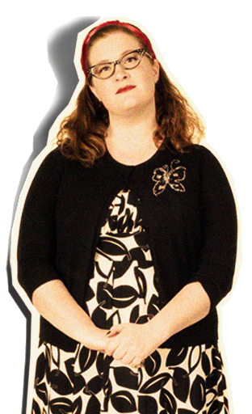


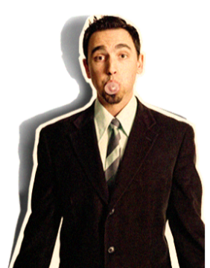
Notes:
Your audience deserves to be treated like royalty. Design a presentation that meets their needs, not just yours.

Slide 26

2
DON’T
PROMISE
ANYTHING
YOU CAN’T DELIVER
Notes:
The second rule is: Spread ideas and move people.

Slide 27
BLAH
BLAH
BLAH
BLAH
BLAH
BLAH
BLAH
Notes:
Your audience didn’t show up to read your 60 page on screen dissertation.

Slide 28

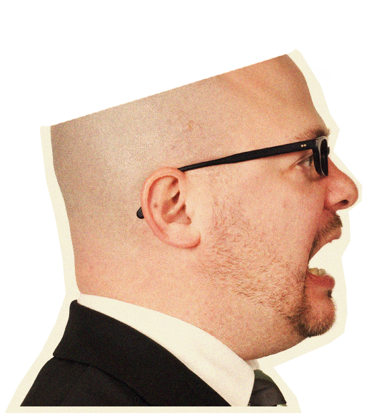
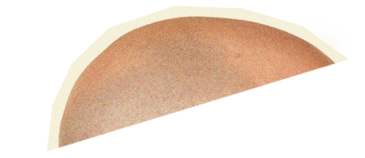

Notes:
…and witness the quality of your thought.

Slide 29



3
SHOW
REAL
INTEGRITY
Notes:
The next rule is: Help them see what you are saying.

Slide 30


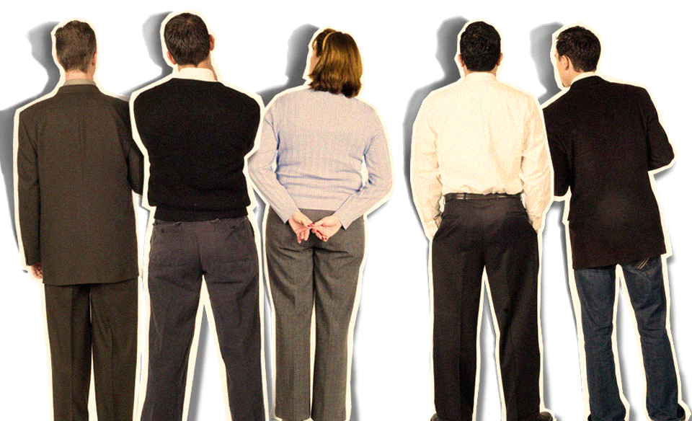

Notes:
Half of the people in your audience are verbal thinkers and the other half are visual.

Slide 31

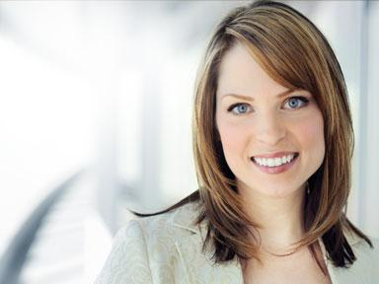









Notes:
Combining minimal text with meaningful visuals means that you’ll reach everyone.

Slide 32










4
BE
PROFESSIONAL
Notes:
Rule number 4: Practice design, not decoration.

Slide 33
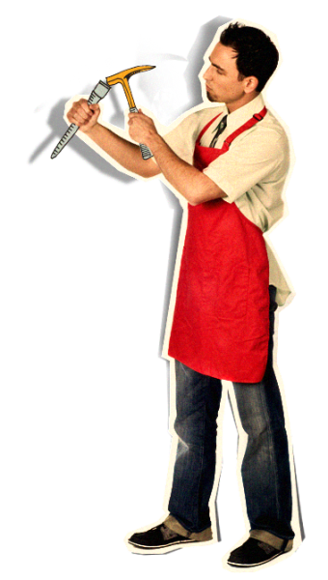

Notes:
Any writer or designer will tell you that 90% of the creative process…

Slide 34






















































Notes:
…is destructive.

Slide 35

















5
BE
HONEST
Notes:
The last rule is: Cultivate healthy relationships (with your slides and your audience)

Slide 36

Notes:
But the question remains—Why go to all this trouble?

